Slide 1

Tier Splitting using Static Analysis
Presenter ： Xinran AI
Promoter：Prof. Dr. Coen De Roover
Guidance by: Laure Philips
Jens Nicolay
Notes:
Hello, everybody. My name is Xinran AI. I am going to present my thesis，the title of my thesis is tier splitting using static analysis

Slide 2
Index
Problem State
Background Knowledge
Program slicing
Abstract Interpreter
Case study of slicing on State graph
Implementation of JipdaSlicer
Validation
Conclusion
Contribution
Future work
2
Notes:
The structure of my presentation is list in index. First I will introduce the existing problem and motivation of my thesis. After introduce the background knowledge, I will put forward case study to explain conceive of solution. And then elaborate the implementation of new solution and show the validation. In the last I will give the conclusion of my thesis.

Slide 3
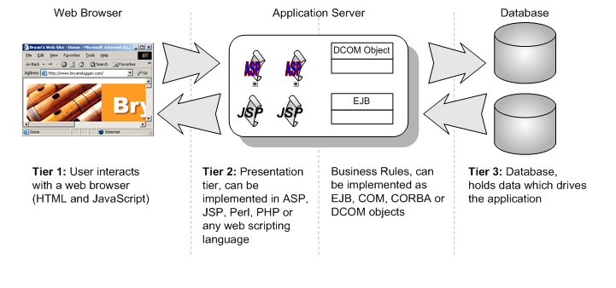
Problem State
Enable web applications with more interactive features is increasing complexity of web application development in typical three tier architecture.
3
Notes:
Today, people can use web application in everywhere and the diverse functionalities make our live more and more convenience. And also more and more interactive features make development in typical three tier more complexity than before. Because in typical three tier architecture each tier have its own technique stack and require manual combination of them. As I show in this picture, normally html, Javascript is used for development client tier. Dependent on the which web framework chosen by developers, a specific programming language for server tier is required. And structured query language is widely used to database development.

Slide 4


Problem State
Solution: Tierless program language
Good enough?
Investment of novel language
Effort to familiar with a new programming language
Effort on annotate tier information
Error-prone
HOP
4
Notes:
Aiming to reduce this kind of complexity, tierless program language emerges at the right moment. Some current solution invest on a novel programming language. However, the developers have to spend time on getting familiar with a new language. And normally this novel technique requires developer annotate tier information carefully. So in some way, this novel programming language doesn’t reduce the effort on development web application.

Slide 5

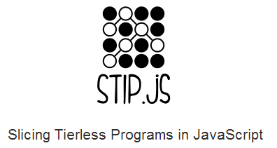

Problem State
Solution: Tierless program language
Existing technologies such as JavaScript with distributed features to cater for tier splitting seems more beneficial.
https://soft.vub.ac.be/~lphilips/jspdg/stip/stip-web/stip.html
HOP
5
Notes:
So we turn to extend current technology, like JavaScript. Node.js is a web framework enable to run JavaScript on server tier. In the view of expandability of JavaScript, we already allow our tier splitting tool named Stip.Js to distributed tierless JavaScript code into client and server tier.

Slide 6
Problem State
A tierless JavaScript code generator
only require annotate code with
@client and @server.
Static analysis source code based on abstract interpretation result in state graph
Construct Program Dependence Graph(PDG) on top of state graph
Apply program slicing technique on PDG
Distribute sliced code into client tier and server tier.
6
Notes:
And Stip.js only requires developers annotate their code with @client and @server. To completes tier splitting, Stip is based on following idea.

Slide 7
Problem State
Motivation
Develop in a new slicing algorithm, called JipdaSlicer, which can slice on state graph directly without building any intermediate presentation.

Slide 8
Background Knowledge
Program slicing
Abstract Interpreter
8
Notes:
Now I will introduce two theoretical foundation of my thesis.

Slide 9
Program Slicing
Weiser’s static program slicing theory:
Definition:
A slice S of program P, is obtained from a specific slicing criterion denoted as a pair of value <i, V>, where i is the line number of statement in P, and V is set of variables defined or used at i.
A slice S can be obtained by deleting zero or more statements from program P. Meanwhile, P and S must behave the same with respect to <i,V>.
9
Notes:
If we use i to denote the line number of a statement in program and V is set of variables defined or used at i. the program slice on line I is obtained by delete one or more statements from program. And only keep the statements which have effect on the variables in line i. and the slicing result must keep same behavior as it involved in original program. Weiser’s program slicing theory is established on flow graph. In his flow graph, Node denotes for statement in program and edges is flow relations between nodes. The process of slicing is done by data analyasis on flow graph. In later,

Slide 10
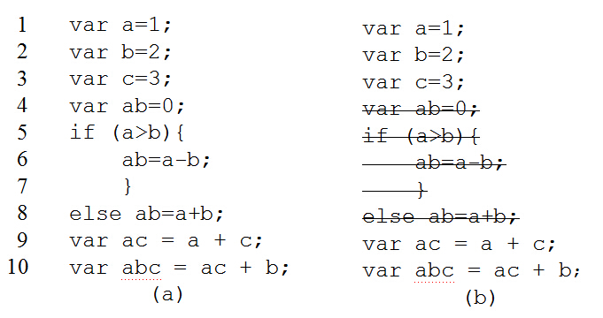
Program Slicing
Weiser’s static program slicing theory:
Figure 1(a) source JavaScript program; (b) get slice S out of slicing criteria <10,{abc}>
10
Notes:
Here is an example intuitive to explain the definition of program slicing. The left part is source code. And right part in sliced code get out of statement no. 10 with variable {abc}. From the result we can see, the program get rid of statement in line 5, 6 7 and 8, because the execution of these four statements will not influence on the value of [abc]. So the computation result of abs in two version of program is the same

Slide 11
Program Slicing
Static slicing on Program Dependency Graph(PDG)
PDG proposed by J. Ferrante et al..
Data dependency in PDG
If a statement S’ use the variable defined at statement S without redefining of this variable during the execution, then statement S’ is data dependent on statement S.
Control dependency in PDG
If a statement S’ is control dependent on statement S, there will be two edges out of S, the “True” edge will lead to execute on S’, “False” edge will lead the program jump to another statement.
11
Notes:
In later, J. Program Dependency Graph is most intermediate representation of program used to get program slice. Similar with Weiser‘s theory, the node in PDG is represent for statement and edge is dependences between each node. And each PDG has an entry node to denote the entry of program. Two very important concept in PDG is data dependency and control dependency between node. The slice is obtained by back traversal on PDG from selected node.

Slide 12
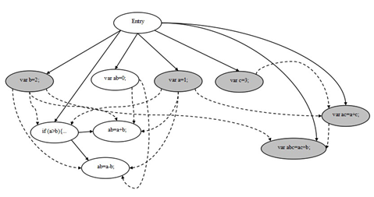
Program Slicing
Static slicing on Program Dependency Graph(PDG)
Backward traversal
1
2
3
4
5
6
7
8
9
10
var a=1;
var b=2;
var c=3;
var ab=0;
if (a>b){
ab=a-b;
}
else ab=a+b;
var ac = a + c;
var abc = ac + b;
Program slicing on slicing criteria <10,{abc}>
12
Notes:
This picture explain how to get program slice on PDG. The gray node is the slice on slicing criterion <10,{abc}>. In the figure, a solid line denotes a control dependency, a dashed line denotes a data dependency. Slicing starts by searching the node that represents line 10, and then traverse backward along dependency edges from it and mark all the visited nodes. In the first traversal, nodes represent for statement in line 2 and line 9 are visited. In second step, backward traverse the dependences edges from the node you marked in first traversal. Iterative second step until all marked node on the path from slicing node to entry node.

Slide 13
Program Slicing
State of the art of Program Slicing
Method
Dynamic and conditional program slicing
Backward and forward traversal
Application
Debugging
Testing
Software maintain
Re-engineering
Web security
13
Notes:
Beside static program slicing, this technology has already be extended into dynamic and conditional program slicing which on contrast to static program slicing, take account into input of program. And in different direction of traversal on graph structure , program slicing can be classify into backward and forward traversal. And program slicing now is widely used in debugging testing software maintain, re-engineering and web security.

Slide 14
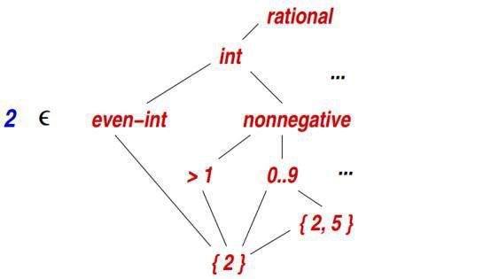
Abstract Interpreter
Abstraction is used to depict property
Syntax and semantic is abstract interpretation of program
A summary of behavior of program.
Value abstractions
14
Notes:
Now, I’m going to introduce Abstract Interpreter. This is the notion of using abstract concept to describe the property of concrete concept. For example, by abstraction, we can say value 2 is an integer, or an even-integer, or is a non-negative value, or an digit whose value bigger than 1. And in computer programing, Syntax and semantic is abstract interpretation of program used to summary the behavior of program.

Slide 15
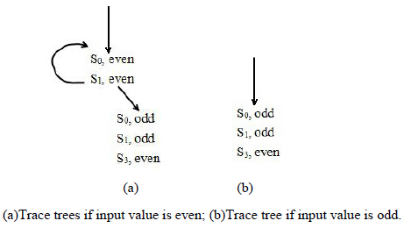
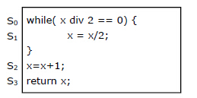
Abstract Interpreter
Static analysis based on abstract interpretation
Try to simulate the execution of program
15
Notes:
Static analysis based on abstract interpretation is the process to simulate the execution of program. So that we can predicate the behavior of program. As I show in this slide, after abstract all number into two type, odd and even. the trace trees give us the two possible execution of the code in left. So we can know if the input is odd, the loop wouldn’t be executed.

Slide 16
Abstract Interpreter
CESK-machine abstract interpreter
is used to translate a source language, which defines source component, to a target language which augment source language with frame expression to specify the permission of component.
It decompose program into four components: a (C)ontrol component, a (E)nvironment, a (S)tore and a (K)ontinuation.
C: expression in functional programming
E: map a value to its address
S: map an address to its value
K: the continuation state of current symbol
When evaluate on atomic expression and (complex) expression
Atomic expression is return the value of expression itself
(Complex) expression is return atomic expression and the continuation in every evaluate step
16
Notes:
CESK-machine is a machine based abstract interpreter which can used to analyse the behavior of source language and translate it into target language.

Slide 17
Abstract Interpreter
Example of evaluation:
given a let bound expression (let ([v exp]) body)
First evaluated exp
Then bind the computation result to v, then holding the resume to body.
17

Slide 18
Case study of program slicing on state graph
18
Notes:
Now I will introduce the case study of new slicing algorithm

Slide 19
Case study
Make assumption by observation
19
Notes:
Make assumption by observation property of state graph

Slide 20
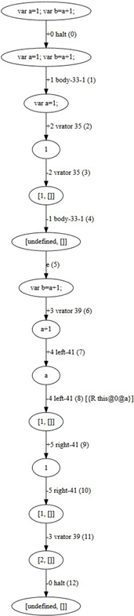
Case study
Make assumption by observation
var a=1;
var b=a+1;
Second line is data dependent on first
line.
Line number
Tag (id)
Positive edge: push stack
Negative edge: pop stack
Identifier
Scope
20
Notes:
By given two statement as shown in slide. We get the state graph as in right. From the code we can know, the second line is data dependent on first line. In state graph, The digit in parentheses on the edges is the edges’ number. Each edge also contains stack information of the abstract interpreter. This consists of a tag of a node. This tag can be seen as an id of each block. The block in a state graph is the node between corresponding positive and negative edges. This node may be a function declaration or an operand in code. A number of blocks compose more complex semantics, such as variable declaration, function call. For example, statement in first line is identified with two blocks: node between edge +1 and -1 identify the value of variable, then edge +2 and -2 identify variable declaration statement. For some edges, it also contains reference and scope information such as the 8th edge. 8th edge tells us, this node refers to an identifier whose value is a, and the scope of a is point to global variable. The edges labeled with positive digit denote for the operation of push stack; on contrast, negative digit denotes for operation of pop stack. In our CESK-machine, push stack indicates the start of evaluation of an identifier or a statement; pop stack indicates the evaluation is terminated. Each corresponding positive and negative digit pair is used to identify semantics of the program.

Slide 21
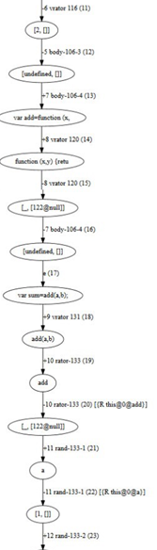
Case study
Make assumption by observation
Examine on control dependency:
Define a function sum(a,b) and call
this function in other statement.
JavaScript allows to define function in two way.
var functioname = function(a,b){ return a+b;}
function sum(a,b) = { return a+b;}
21
Notes:
Also, the control dependency is identified in same way. If we define a function named sum with two formal parameters. If function sum called by other statement, the function call is reflected as identifier reference on state graph. As marked in red rectangle. We have to notice that JavaScript allows to define function in two way： one is use reserve word var to define function as an assignment to a variable. Another one is function declaration.

Slide 22
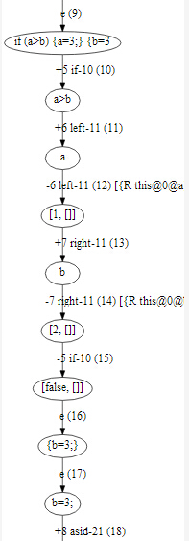
Case study
Make assumption by observation
Checking on state transition of
conditional statement.
example code:
var a = 1;
var b = 2;
if(a>b){
a=3;
}else{
b=3;
}
22
Notes:
This slide show the examination of conditional statement. For each predicates expression, the state graph returns a Boolean result of expression. And the clause will be accessed only when the result is true. And the data dependence in predicates is identified in same way as we introduce in precious slide.

Slide 23
Case study
Three assumptions:
Directly influence statement and variable is found by matching identifiers and scope information on the edges.
Indirectly influence statement and variable is found by iteratively executing to find dependences on directly influence statement and variable we get in each stage of query.
We can replace the code in clause result from false predicates with null value.
Our program slicing is conform to Weiser’s theory:
Algorithm is derived by input slicing criterion<i,V>
23
Notes:
So we put forward three assumption based on our aboservation.

Slide 24
Implementation
24
Notes:
Now I’ll elaborate the implementation

Slide 25
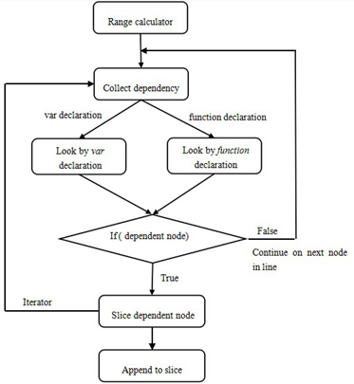
Outline
25
Notes:
This picture shows the outline of implementation based on our assumption. First we need to get the range of statement used to start slicing algorithm in state graph. Then traverse each node in this range and put each node in the dependency query function. As JavaScript allow to define functions in two ways. We need two look up functions to map identifier reference. And if we find the dependent node, the algorithm launch the iterator function to find indirect dependent node and append it to sliced code.

Slide 26
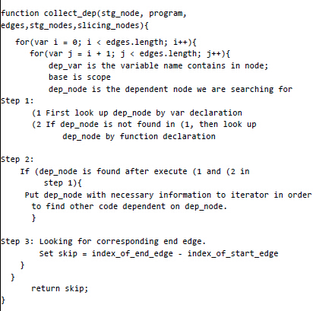
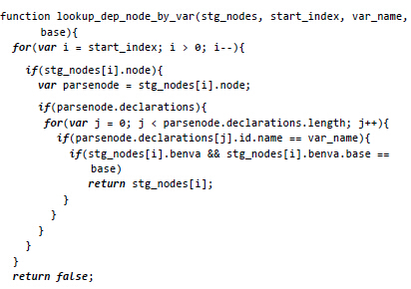
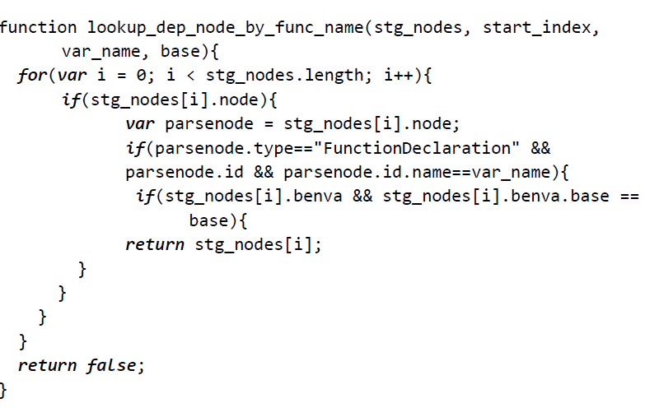
Key functions
26
Notes:
This is the sketch of key functions in new slicing algorithm. The collect_dep function is responsible for collection data or control dependences via searching corresponding identifier. By comparing the value of tag on edges we can get corresponding end edge of each block. Then the evaluation of current identifier is end.

Slide 27
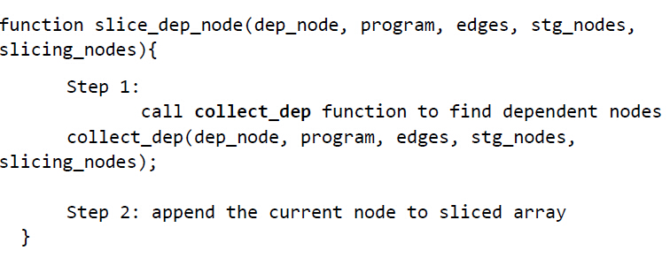
Key functions
27

Slide 28
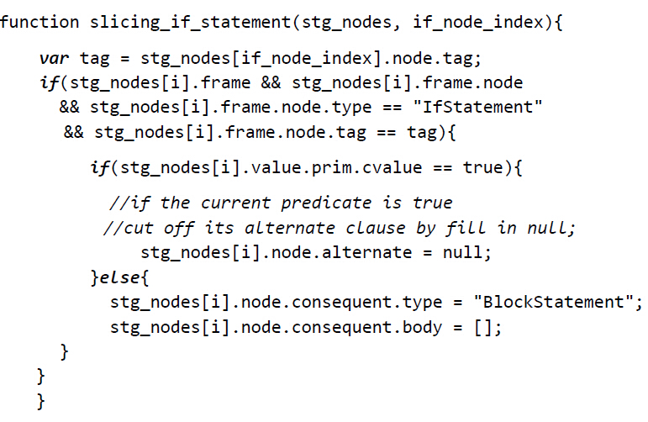
Key functions
28

Slide 29
Validation
29

Slide 30
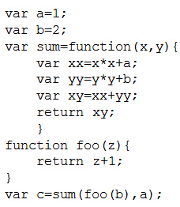
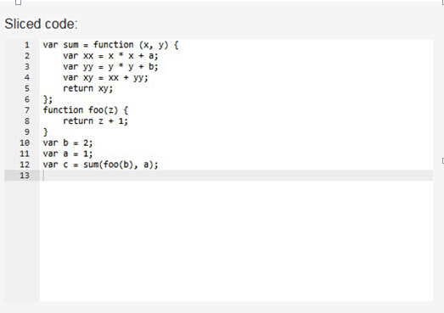
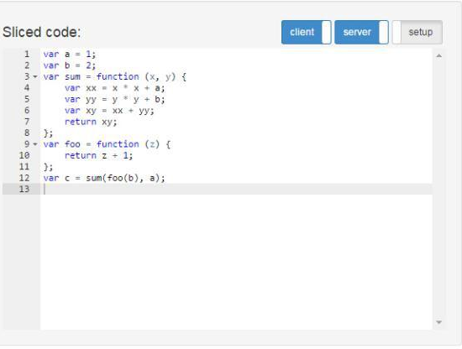
Evaluation
JipdaSlicer
Stip.js
30
Notes:
After test some cases of function invocation, we found both algorithm is good enough to deal with data dependency and control dependency involved in function call. This is the case of interpreocedural function invocation. As we can see from the results, the different is in the order of statement in result. The different way of querying results in this kind of different ordering. In JipdaSlicer, after abstract interpreter invoked by getting the range of selected line, the algorithm evaluates each node in that line in sequence. If the node is bundled with identifier, the node on which it dependent is always found by traversal on state graph to matching the name of variable with scope. So the order of code in the result from JipdaSlicer depends on the position of identifier in selected line.

Slide 31
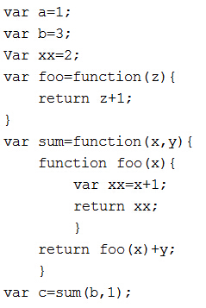
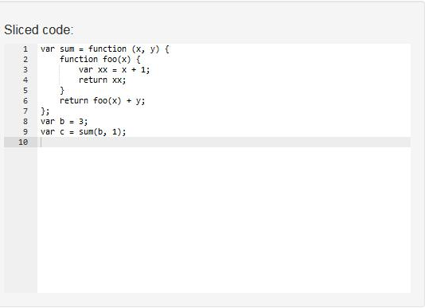
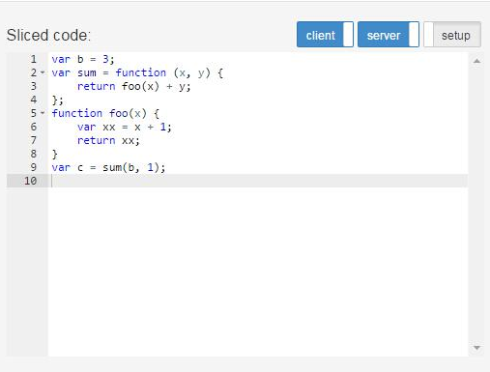
Evaluation
JipdaSlicer
31
Stip.js
Notes:
And also both algorithm can work on nested function declaration

Slide 32
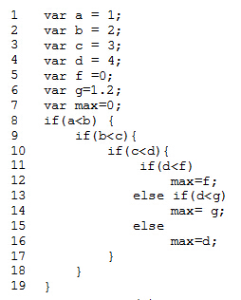
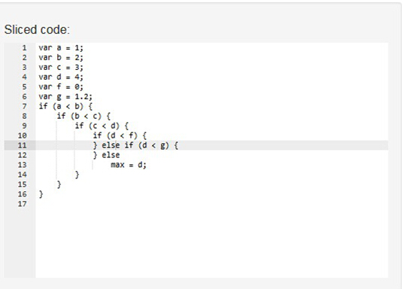
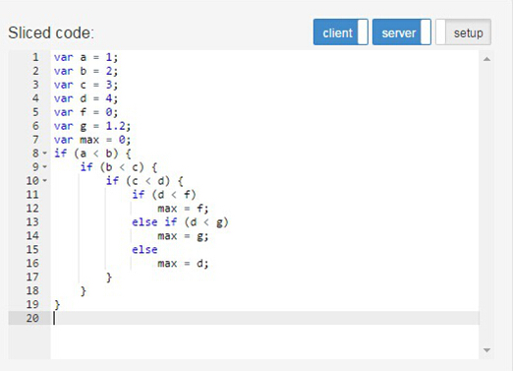
Evaluation
JipdaSlicer
32
Stip.js
Stip.js
Notes:
This is the situation of slicing on conditional statement. To conform our assumption, the result of slicing is return an empty block of false clause. However, in stip in order to keep the syntax structure, it keeps all clause in if-else statement.

Slide 33
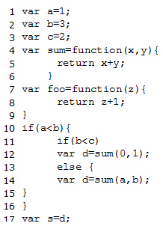
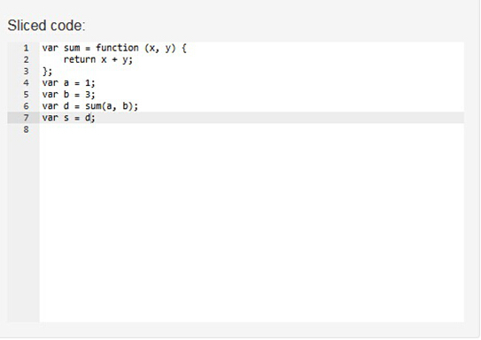
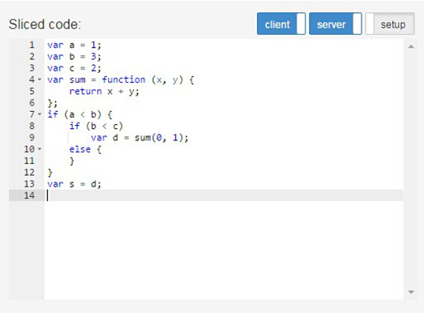
Evaluation
JipdaSlicer
33
Stip.js
Stip.js
Notes:
This test case is in order to examine the different slicing mechanism of slicing conditional statement in JipdaSlicer. If the selected line is not involved in any clause of if-else statement, the result won’t show the syntax structure of conditional statement. The sliced code only involves the statement which is executed during the computation of program. So in this example , the sliced code only keep the statement in line 14 of source code.

Slide 34
Conclusion of Evaluation
The order of sliced code in JipdaSlicer is dependent on the identifiers’ position in slicing criterion.
Powerful enough to analyse control and data dependences.
Is able to maintain syntax structure of if-else statement.
34
Stip.js
Notes:
We can get following conclusions from our evaluation

Slide 35
Conclusion
35

Slide 36
Contribution
Examine if the program dependency graph is necessary to acquire a correct slice of a program.
The general pattern isolates dependencies query from analysis complexity graph stucture.
Correctly reflect syntax structure of conditional statement.
36

Slide 37
Future work
Interpreter design
To process more syntax structure, such as loop statement like while, for
Distributed code
To be able to generate distributed sliced code in Node.js and Meteor.js framework.
Algorithm performance
A dynamic programming algorithm to reduce time complexity of our algorithm
37

Slide 38
Thank you!
Any Questions?
38

